Slide 1
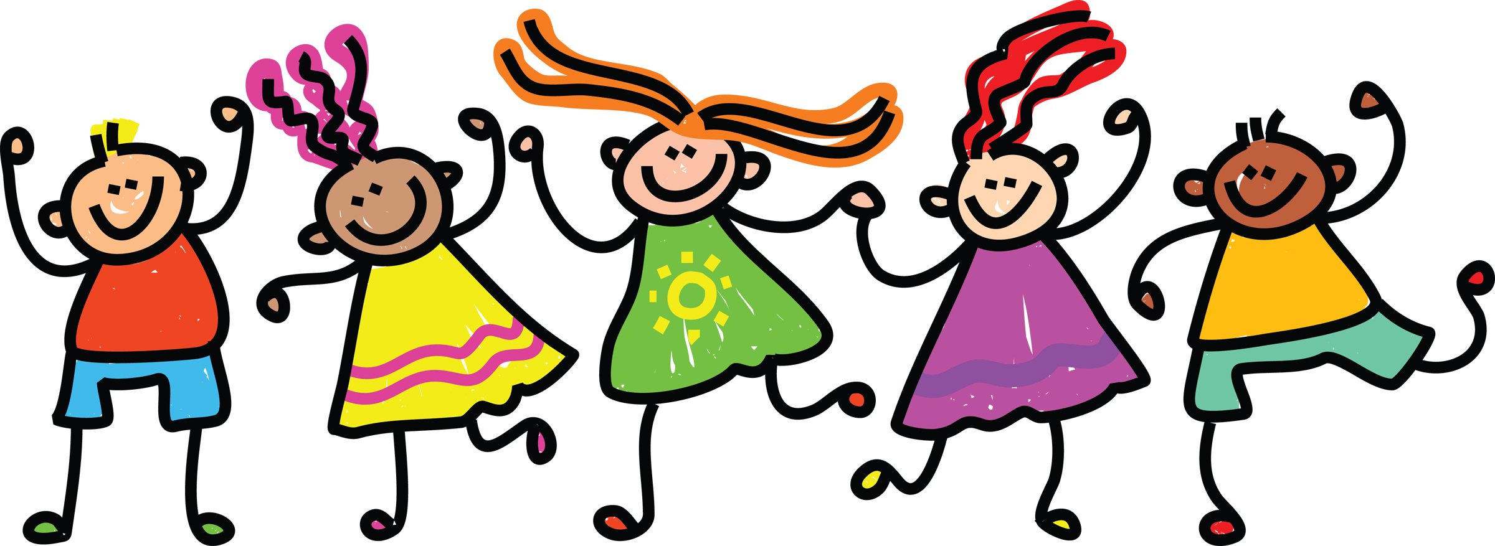
KS1 Dance
We have put lots of resources together to create a booklet of KS1 Dance activities.
Enjoy ☺.

Slide 5
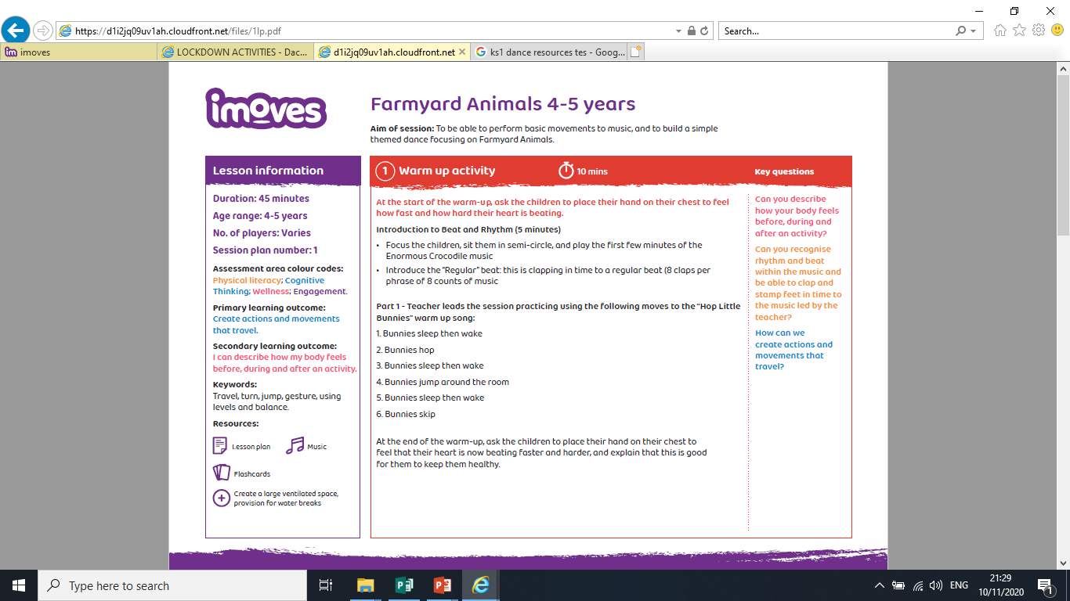
Hop Little Bunnies Song –
See the bunnies sleeping till its nearly noon,
Shall we wake them with a merry tune?
Their so still… are they ill?
Shhhhhhh…….
WAKE UP BUNNIES,
Hop little bunnies hop, hop, hop
Hope little bunnies hop,hop hop,
Hop little bunnies hop and STOP!
If you are learning from home, with help from an adult can you sing the above bunny song and do the different actions? Good luck little bunnies ☺.

Slide 6
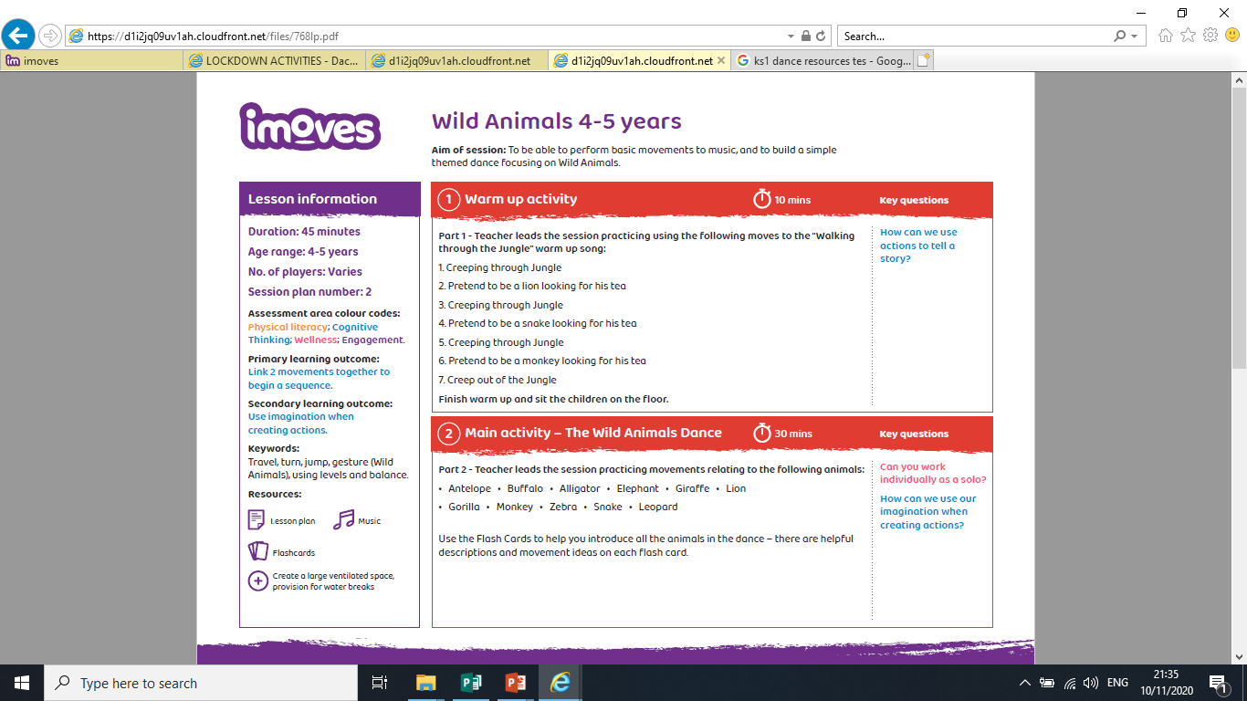
Learning from home –
Can you practice moving through space pretending to be the jungle animals outlined?
Think about how the animal moves?
Fast or slow?
Big or small?
Loud or quite?

Slide 7
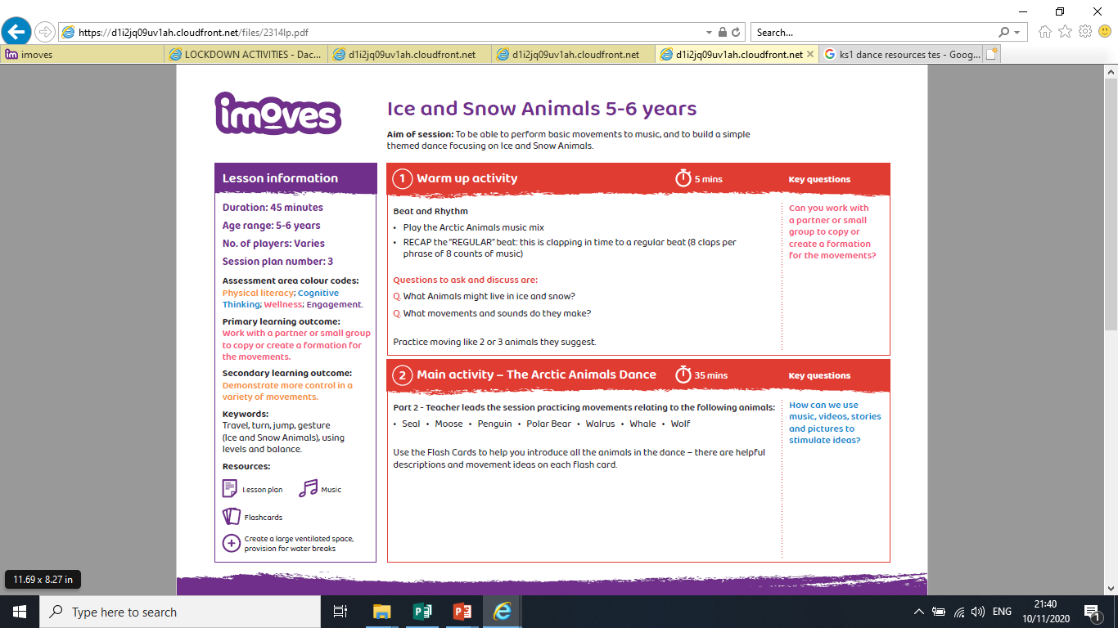
Learning from home –
Can you practice moving through space pretending to be the artic animals outlined?
Think about how the animal moves?
Fast or slow?
Big or small?
Loud or quite?

Slide 8
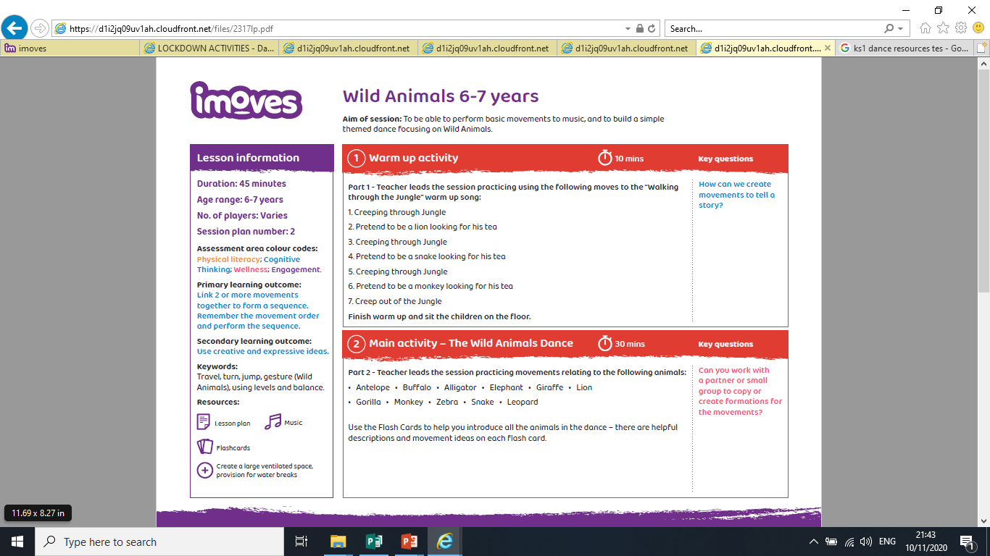
Learning from home –
Can you practice moving through space pretending to be tricky jungle animals outlined?
Think about how the animal moves?
Fast or slow?
Big or small?
Loud or quite?
Good Luck.

