Slide 1
KS1 Ball Skills
Lots of resources put together to create a booklet of Ball Skill related activities.

Slide 4
Clever Catching from home.
Can you….
Complete all the tasks with a member of your family?

Slide 5
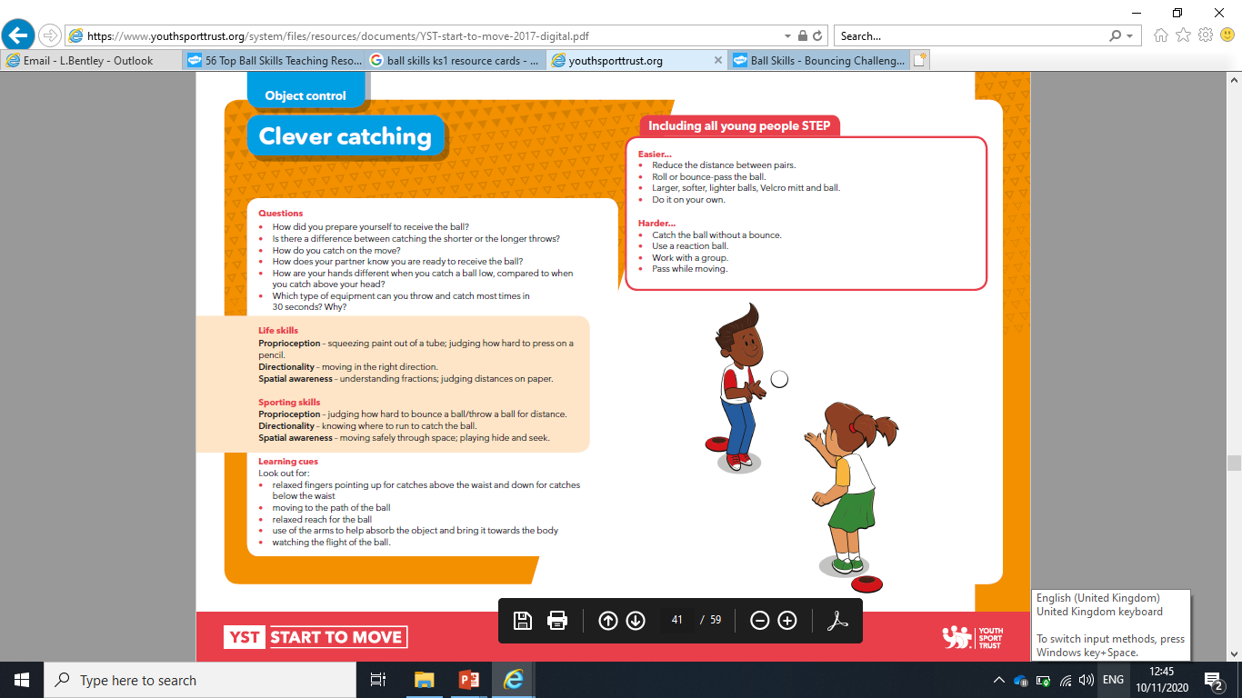

Slide 11
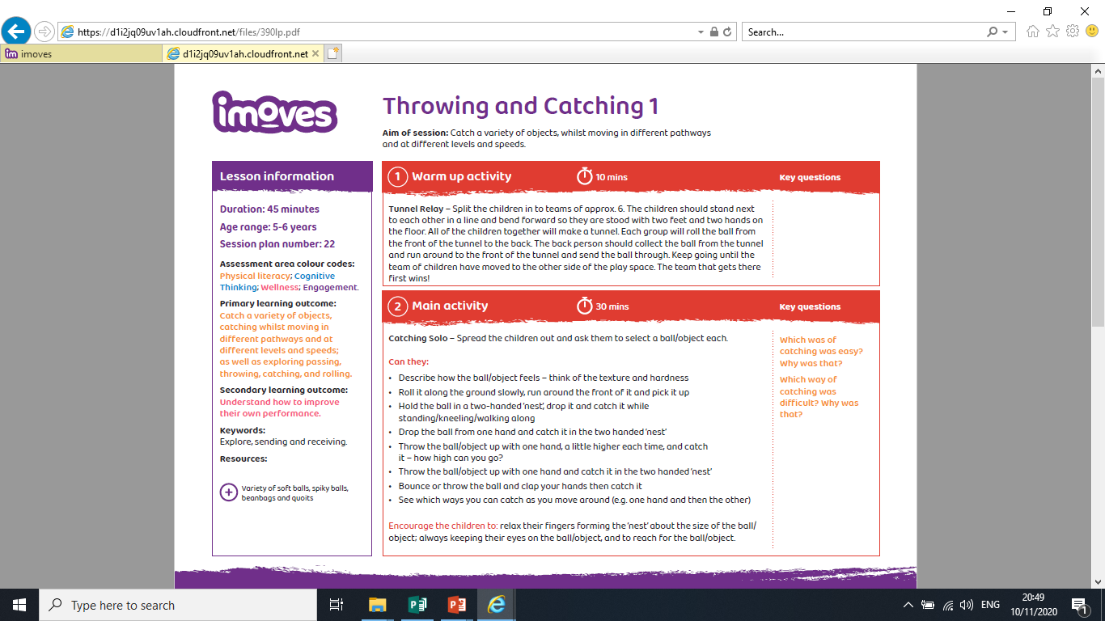
Learning From Home –
Finding a space either outside or inside, can you complete these activities outlined in the bullet points?

Slide 12
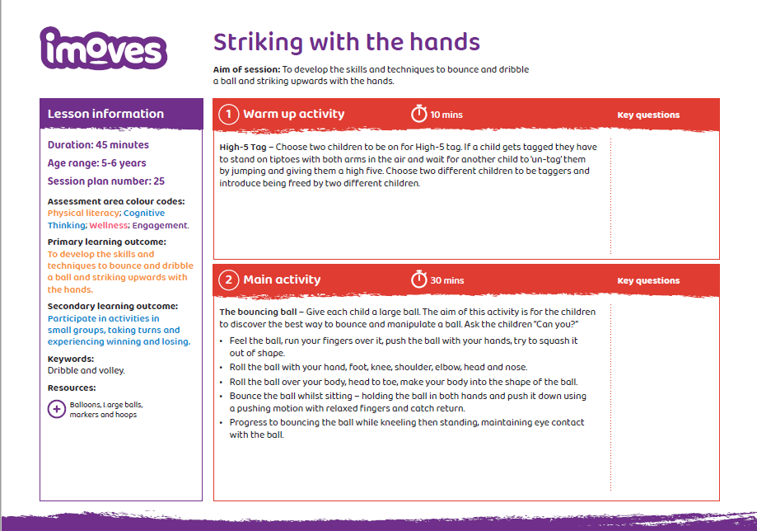
Learning From Home –
Finding a space either outside or inside, can you complete these activities outlined in the bullet points?

