Slide 1
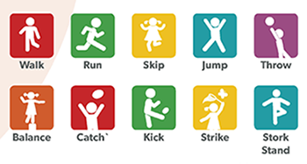
KS1 Fundamentals
Lots of resources put together to create a booklet of ks1 fundamental activities.

Slide 2
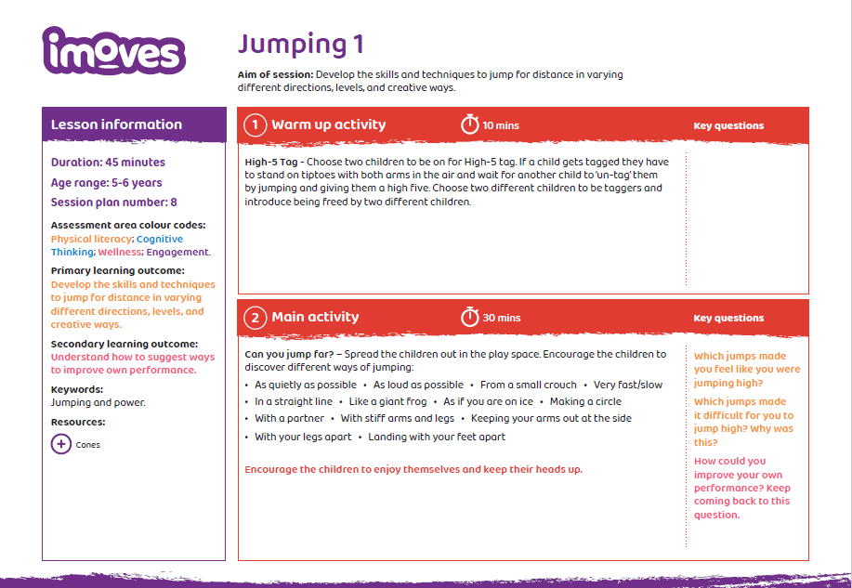

Slide 3
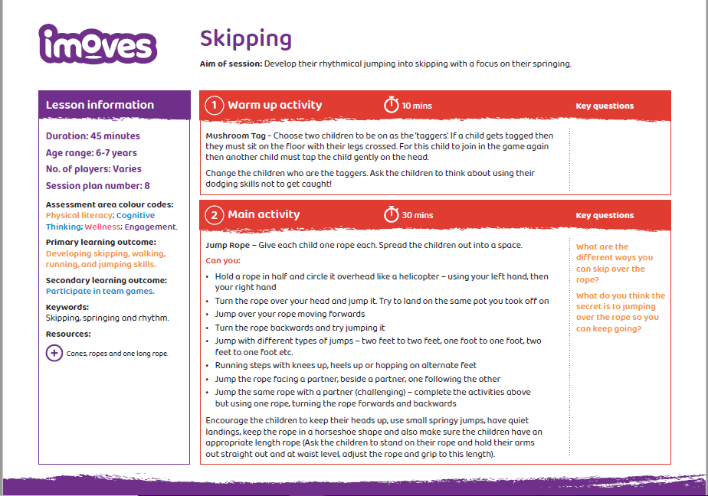

Slide 4
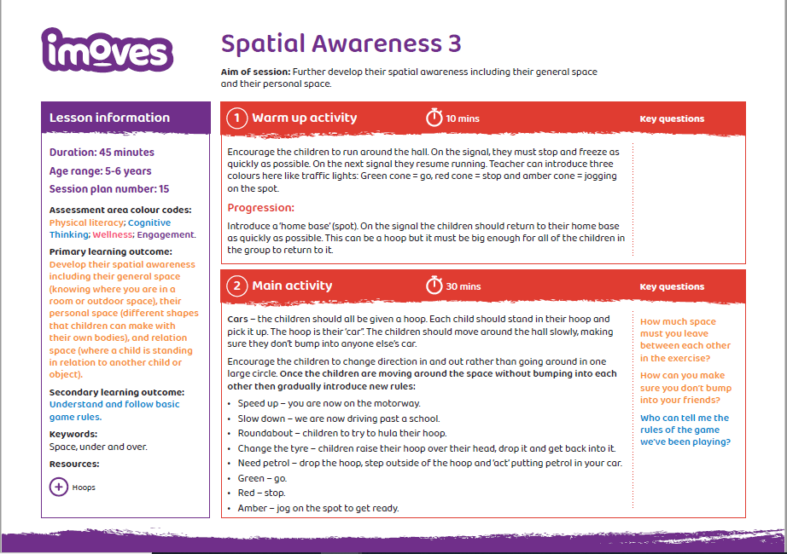

Slide 5
SPACE Movement, co-ordination, agility
Visit the moon In the middle of the hall/playground set up a large white circle (the moon) use cones to do this. If learning from home can you find a blanket to lay down indoors to be the moon? Children must move around the moon in different ways – crawl, slide, hop, skip, jump etc. Children can work alone or in pairs taking it in turns. How do you think you would move in space? Explore outer space Around the moon set up different colour areas (solar systems/galaxies) use different coloured cones for this. If at home could you use cushions? Encourage the children/child to fly to one of these colours and sit down. The coloured cone becomes their rocket ship. The coach says “red rockets 3,2,1 BLAST OFF and all the red rockets fly and visit 5 white cones on the moon landing their rocket at each one. Repeat this for blue and yellow rockets. HARDER: children balance rocket ship (cone/cushion) on their head and move around. EVEN HARDER: balance cone and a tennis ball on their head and move around. Alien Invasion – in school use. put the children into teams 7 or 8 teams of 4 and scatter out a variety of green cones (aliens) children use a small hoola hoop as their space rocket and the run out to collect an alien and return it to their planet (larger hoop). The winning team is the team with the most aliens returned safely. HARDER: Give different coloured cones different amount of points red = 1 blue = 2 yellow = 3 (cross-curricular maths)

Slide 6
Agility
being able to change direction quickly and easily when you need to.
Set up: Make a line of markers on the floor with equal space between them. You can use whatever you have – cones, jumpers or cushions.
Task: Find your way in and out of the cones without touching them. Start slowly then build up your pace.
How quickly can you go without touching a marker or missing a turn?
Extra challenge
To give yourself a bit of extra challenge, place the markers randomly with larger and smaller gaps between them. This may create some tighter turns for you.
How did you find moving between smaller or larger gaps?
Make it easier
To make the task a little easier, take some of the markers away to make the space between them bigger. This should give you more space to move around them.
What difference did this make for you?

Slide 8
