Slide 1
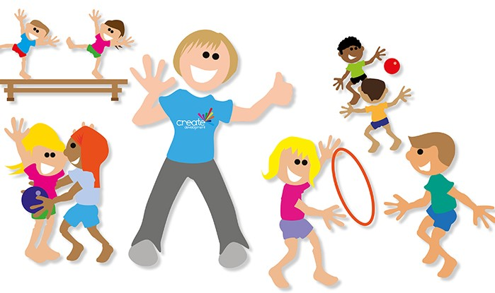
Gymnastics
Lots of resources put together to create a booklet of gymnastic activities.

Slide 2
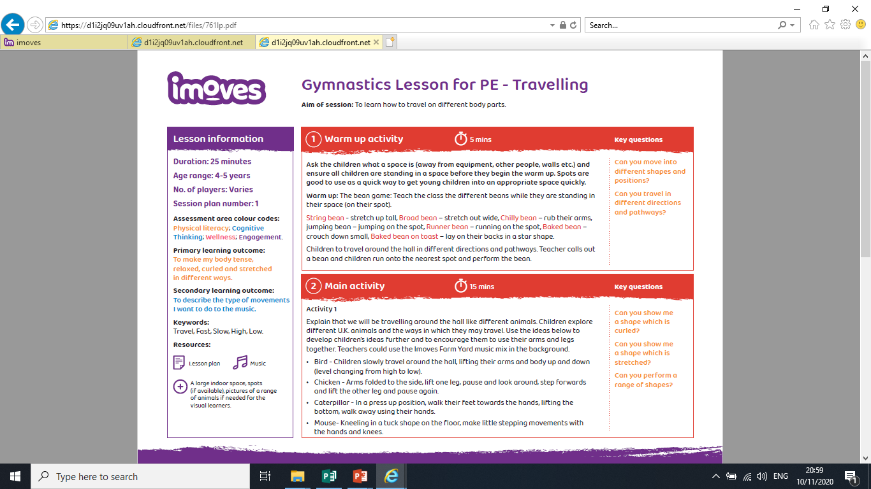
Learning From Home -
If you are completing this activity from home, can you complete the bean game creating different bean shapes?
Can you move around inside or outside like the animals that have been listed? Good Luck ☺.

Slide 3
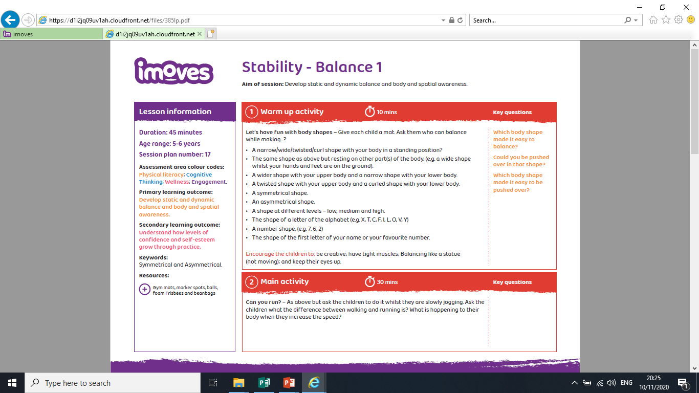
Learning From Home -
If you are completing this activity from home, try to complete each bullet point. What ones can you complete?

Slide 4
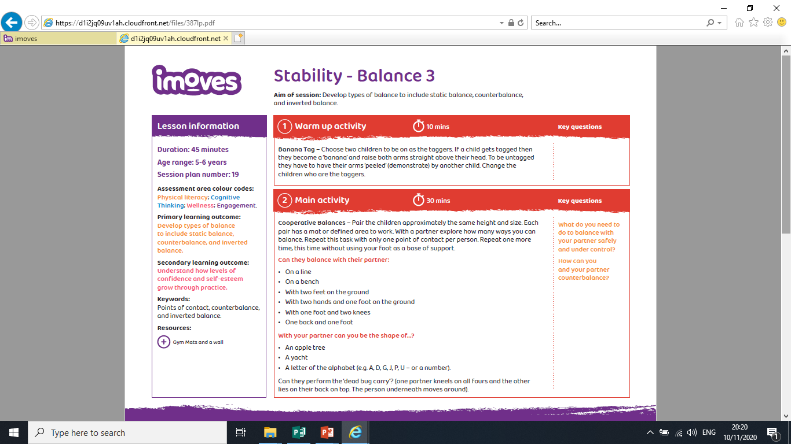
Learning From Home -
If you are completing this activity from home, can you complete these balances with a family member? Good Luck ☺.

Slide 6
Can you perform any of these counter balances?

Slide 7
Can you perform any of these counter balances?

Slide 9
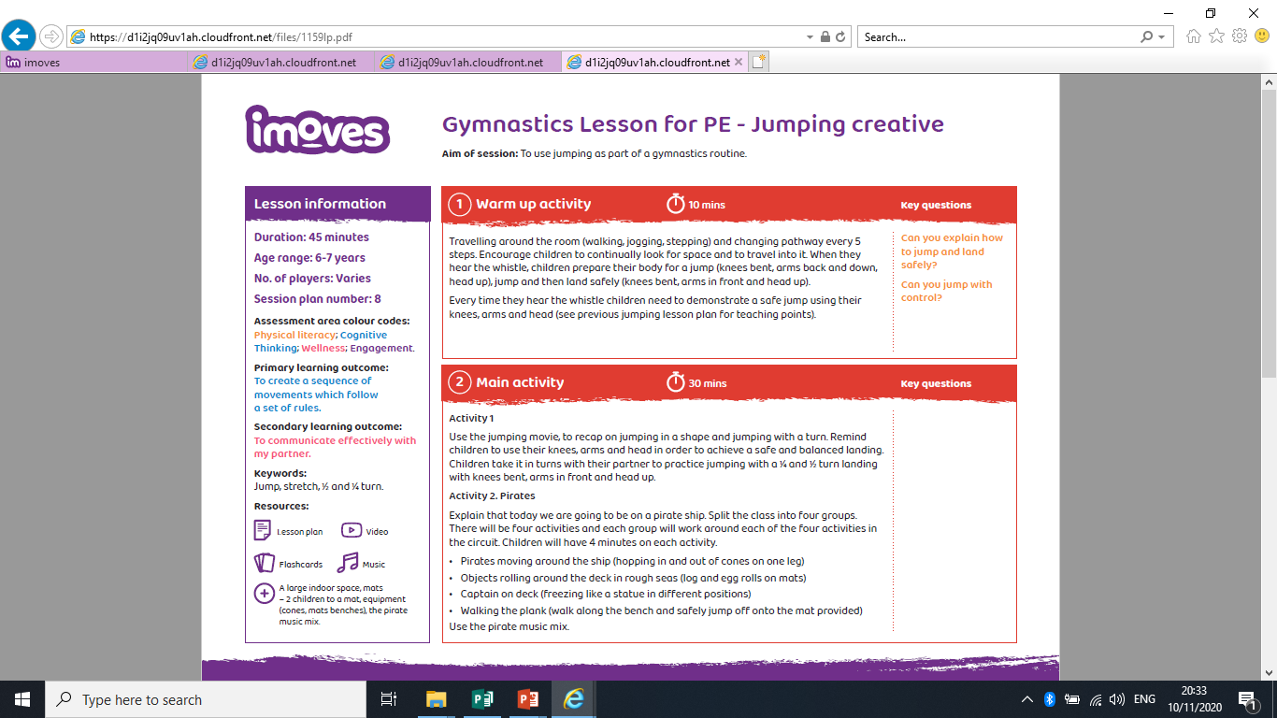
Learning From Home -
If you are completing this activity from home, can you complete these activities in a space indoors or outside? Good Luck ☺.
Instead of a bench, could you create a line and ensure your feet stay on it?

